Slide 1
BUSQOM 1080 Simple Linear Regression II
Fall 2020
Lecture 10
Professor: Michael Hamilton

Slide 2
Lecture Summary
Review simple linear regression. [5 Mins]
Explain ordinary least squares approach to regression. [5-10 Mins]
Confidence intervals and prediction intervals. [5 Mins]
R² [5 Mins]
Preview: regression with multiple independent variables. [5 Mins]

Slide 3
Data for lecture
Save mlb.txt in your working directory
mlb =read.table("mlb.txt", sep = "\t", header = T)
30 Teams
Stats from ‘17
Column Name | Variable Definition
AvgRuns | Runs Scored Per Game
OBP | On-Base Percentage
SLG | (Total Bases)/(At Bats)
OPS | One base plus slugging
HR | Homeruns
Many others | ~Baseball Stuff~

Slide 4
Review: Simple Linear Regression
Assumed Probabilistic Linear Model: Assume a linear relationship between X & Y exists
Error term is assumed to be Normal with mean 0
Observed Y values can be expressed as:
Use data to estimate that linear relationship with a straight line:
The straight line (average)
Deviation from the line

Slide 5
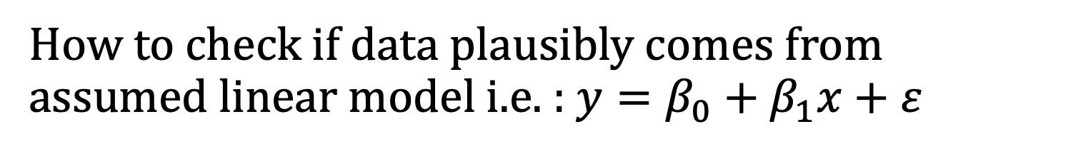
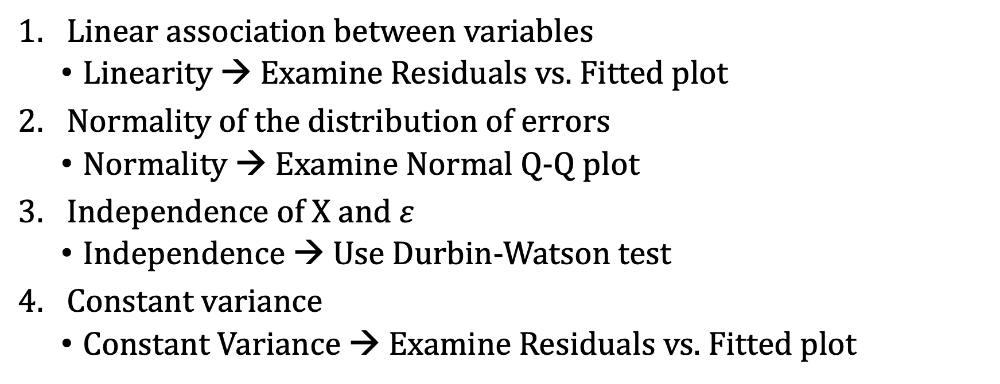
Probabilistic Linear Model: Assumptions
How to check if data plausibly comes from assumed linear model i.e. : $y=β_{0}+β_{1}x+ε$
Linear association between variables
Linearity → Examine Residuals vs. Fitted plot
Normality of the distribution of errors
Normality → Examine Normal Q-Q plot
Independence of X and $ε$
Independence → Use Durbin-Watson test
Constant variance
Constant Variance → Examine Residuals vs. Fitted plot

Slide 6
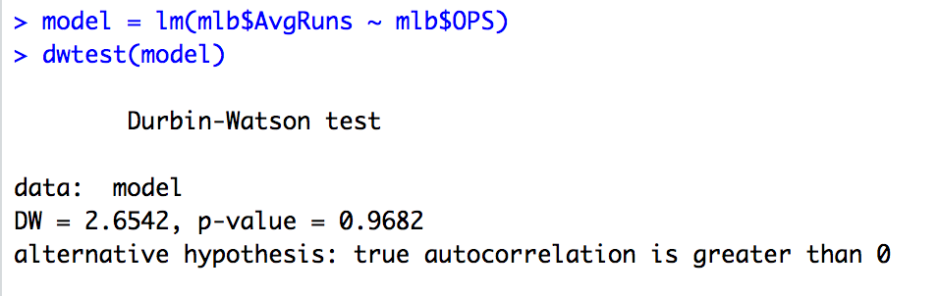
Regression Assumptions: Independence
install.packages(“lmtest”)
Use dwtest(model)
Testing if residuals from regression model are correlated:
Large p-value → Residuals not correlated (GOOD)
Small p-value → Correlated residuals (BAD)

Slide 7
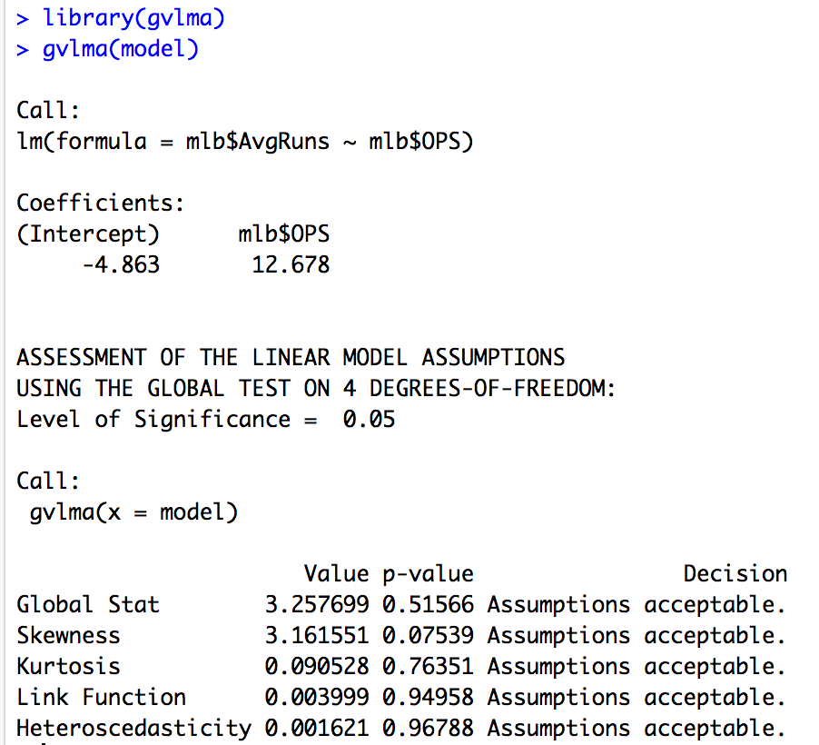
Topic: Checking Assumptions using gvlma()
install.packages(“gvlma”)
Data satisfies regression assumptions

Slide 8

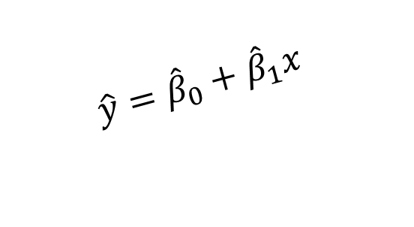
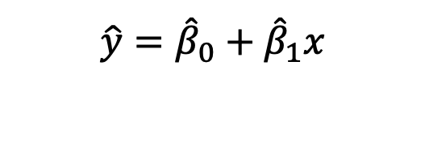
Topic: How Linear Regression is Fit
Data: (x_{i}, y_{i}) pairs
Goal: Find a linear model (straight line) that best fits the data
Equivalently: Find coefficients ${\hat{β}}_{0}$, ${\hat{β}}_{1}$ for linear model:
Qu: How do we find this model (i.e line of best fit)?
$$\hat{y}={\hat{β}}_{0}+{\hat{β}}_{1}x$$
y
60
40
$$\hat{y}={\hat{β}}_{0}+{\hat{β}}_{1}x$$
20
0
x
0
20
40
60

Slide 9
Topic: How Linear Regression is Fit
How would you draw a line through the points?
How do you determine which line is the ‘best fit’?
If there were very many points, how could a computer find the line?
y
60
40
20
0
x
0
20
40
60
Notes:
42

Slide 10
Topic: Ordinary Linear Squares (OLS)
Idea: OLS chooses the line that minimizes the errors, i.e. sum of squared residuals (squared distances from the observed y values and the line)
y
^
ε
^
4
ε
2
^
ε
^
ε
1
3
x
Notes:
52

Slide 11
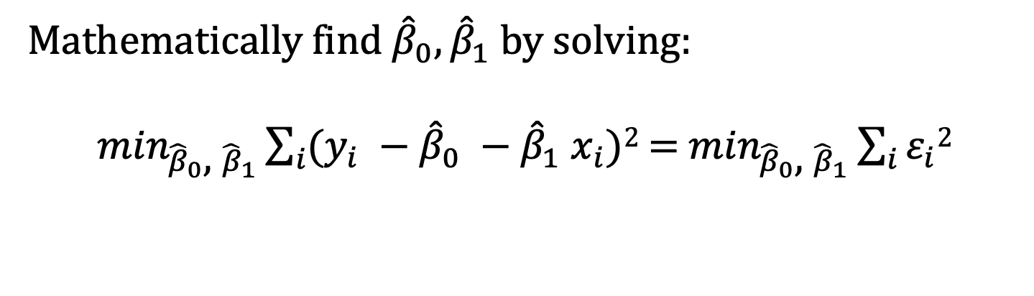
Topic: Ordinary Linear Squares (OLS)
Mathematically find ${\hat{β}}_{0},{\hat{β}}_{1}$ by solving:
$\min_{{\hat{β}}_{0}\text{, }{\hat{β}}_{1}}\sum_{i}{(y_{i} −{\hat{β}}_{0} −{\hat{β}}_{1} x_{i})}$² = $\min_{{\hat{β}}_{0}\text{, }{\hat{β}}_{1}}\sum_{i}{ε_{i}2}$
y
^
ε
^
4
ε
2
^
ε
^
ε
1
3
x
Notes:
52

Slide 12
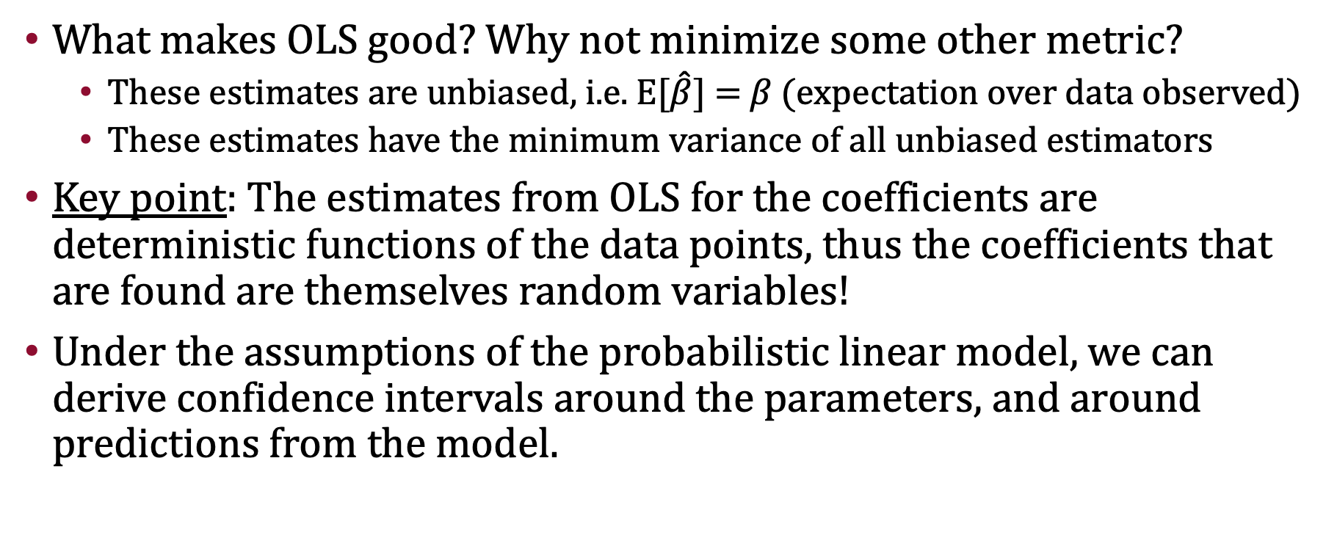
Topic: Ordinary Linear Squares (OLS)
What makes OLS good? Why not minimize some other metric?
These estimates are unbiased, i.e. E[$\hat{β}$] = $β$ (expectation over data observed)
These estimates have the minimum variance of all unbiased estimators
Key point: The estimates from OLS for the coefficients are deterministic functions of the data points, thus the coefficients that are found are themselves random variables!
Under the assumptions of the probabilistic linear model, we can derive confidence intervals around the parameters, and around predictions from the model.
Notes:
52

Slide 13
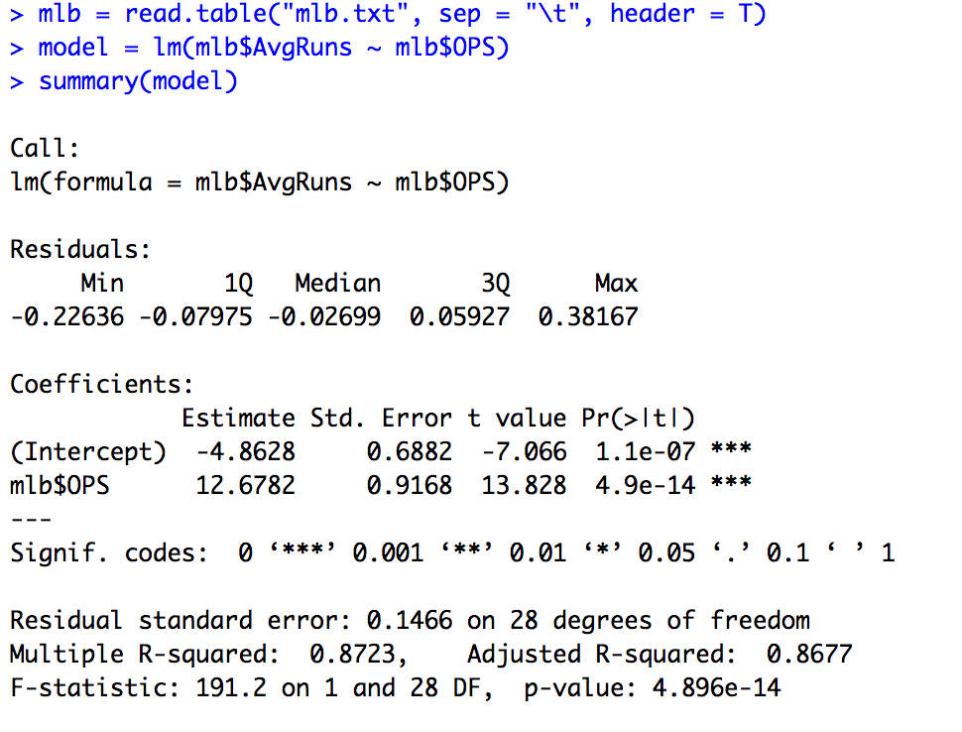

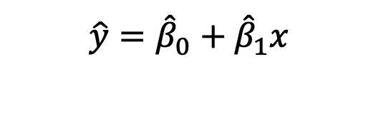
Review: Simple Linear Regression in R
Data: (x_{i}, y_{i}) pairs
Use lm() to do OLS regression (note this is by default in R)
Finds coefficients ${\hat{β}}_{0}$, ${\hat{β}}_{1}$ for linear model:
Example: Explain AvgRuns by team OPS
$$\hat{y}={\hat{β}}_{0}+{\hat{β}}_{1}x$$

Slide 14
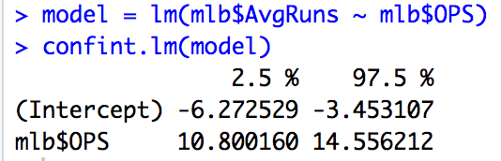
Confidence Interval for the Fitted Parameters
Saved regression model
Confidence Interval for Slope Interpretation :
AvgRuns increase by 1.08 to 1.4 for a .1 increase in OPS

Slide 15
Topic: Prediction with Lin. Reg.
The goal of regression is often prediction. If the assumptions of the model Assumed Probabilistic Linear Model hold, we can use that understanding of the data generating process to predict responses of new observations!
Confidence interval for the mean response (μ = E[y|x])
The interval of values for the mean among observations with a specific x value
Typically a narrower interval; easy to predict the population mean
Prediction interval for an individual new observation (just y)
The interval of values for a specific observation with a specific x value
A much wider interval; difficult to predict a new observation (more variability)

Slide 16
Topic: Prediction with Lin. Reg. in R
For a given set of values x₁, …, x₅ (say, 5 teams), the predict() function calculates:
5 Fitted values (plug each x into regression equation)
5 Confidence intervals for the average y for each x
5 Prediction intervals for a new observation for each x
In R:
Create dataframe with values to be predicted from
predict(model, new data, interval = “confidence”, level = 0.95)
predict(model, new data, interval = “prediction”, level = 0.95)

Slide 17
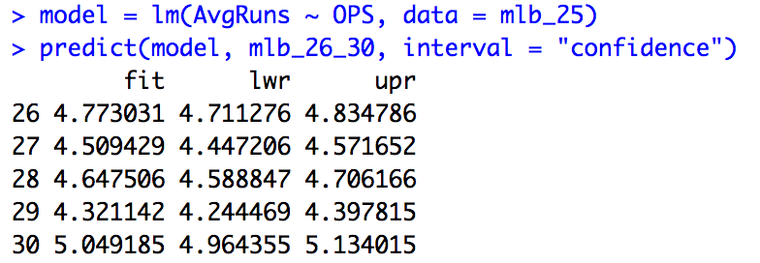
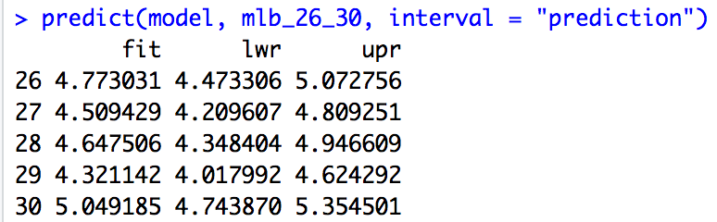
Topic: Prediction with Lin. Reg. in R
New data must be a data frame.
Use the same column names as original dataset
Same
fitted
values
95% confidence interval for AvgRuns
when OPS is .739
95% prediction interval for AvgRuns
when OPS is .739

Slide 18
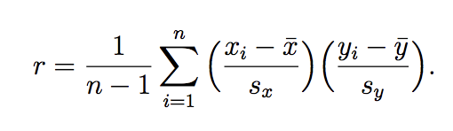
Topic: R² for Linear Reg.
R² (R-Squared) is the proportion of variability in Y accounted for by the model (i.e. predictor variable(s)) (note: Sometimes called the Coefficient of Determination)
Formula: R² = SS Regression/ SS Total
For simple linear regression note R² is equal to r² (the correlation squared!)
General formula compares the sum of squares due to the regression (model) with the total variability
Example: Value of 0.50 indicates that, 50% of the overall variation in the outcome has been “explained” by the explanatory variable
Reading R²: Values near 1 look imply a tight clustering of the data about some line, while smaller values correspond to scatterplots with more spread of the points around the best fit line.
0 means no linear relationship between X and Y
1 means all of the data falls on a perfect straight line

Slide 19
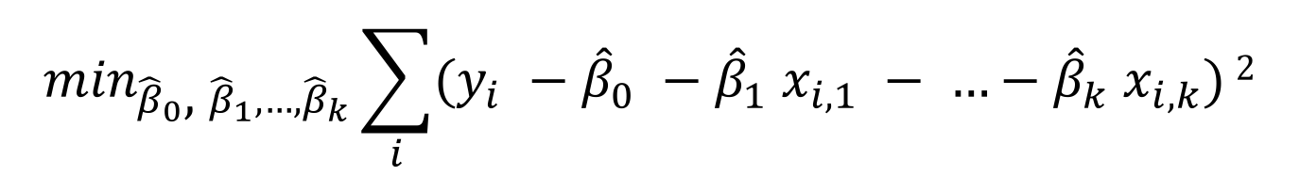
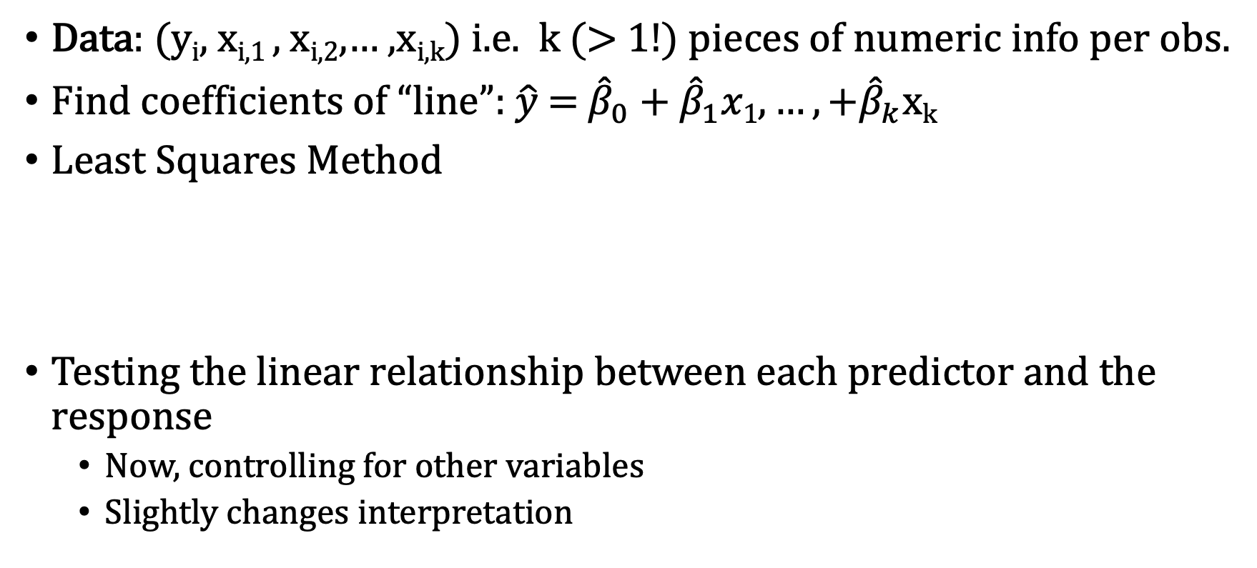
Preview: Beyond Simple Linear Regression
Data: (y_{i}, x_{i,1} , x_{i,2},… ,x_{i,k}) i.e. k (> 1!) pieces of numeric info per obs.
Find coefficients of “line”: $\hat{y}$ = ${\hat{β}}_{0}\text{ +} {\hat{β}}_{1}x1, …,+{\hat{β}}_{k}$x_{k}
Least Squares Method
Testing the linear relationship between each predictor and the response
Now, controlling for other variables
Slightly changes interpretation
$\min_{{\hat{β}}_{0}\text{, }{\hat{β}}_{1}, …,{\hat{β}}_{k}}\sum_{i}{(y_{i} −{\hat{β}}_{0} −{\hat{β}}_{1} x_{i,1} − …−{\hat{β}}_{k} x_{i,k})}$²

